Slide 1
Amazon Fine Food Reviews classification
- Al Baraa Ibrahim Melhem

Slide 2
Data

Slide 3
Data description
This dataset consists of reviews of fine foods from amazon. The data span a period of more than 10 years, including all ~500,000 reviews up to October 2012. Reviews include product and user information, ratings, and a plain text review. It also includes reviews from all other Amazon categories.

Slide 4
The Importance of Reviews
1.They Increase Your Sales
People are very hesitant to buy a product if there are no reviews for it. Shoppers want some kind of assurance that they’re getting a quality item before they hand over their money. And the only way to achieve this online is to check reviews.
here are a few findings that Business Insider discovered when analyzing Amazon reviews:
An item with one review is 65% more likely to be purchased than an item with no reviews.
One-third of consumers won’t buy a product that doesn’t have any reviews.
Amazon reviews are trusted more than any other type of review.
On average, positive reviews increase sales by 20%.

Slide 5
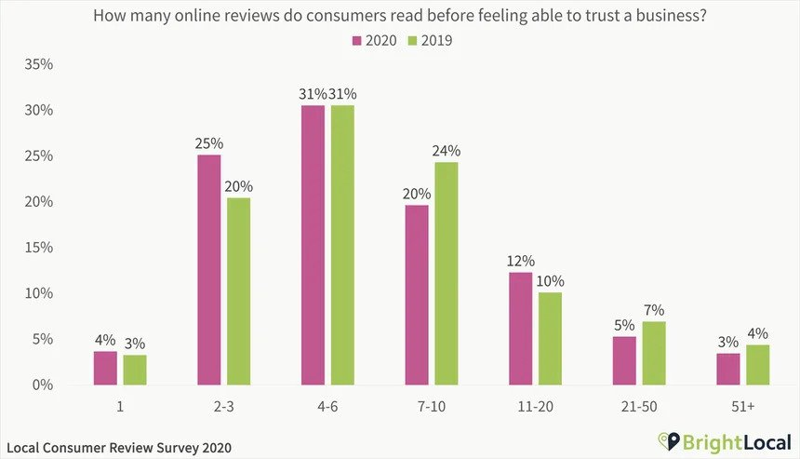
2.They Build Trust with Your Customers
So, why will most people not buy your product if it doesn’t have any reviews? Because they don’t trust you.
They’ve never met you and have no idea who you are. They don’t know whether you’re an honest seller or if you’re trying to scam them. Sure, you say your product is great, but so does every other seller.
The best way to build trust is through reviews. A recent survey from Bright Local found that the average consumer needs to read 10 reviews before they trust a business.

Slide 6
3.They Improve Your Search Rankings
In order for people to buy your products they need to find them first, which is why increasing your rankings in Amazon search results is so important. And because a large number of positive reviews is a sign of a high-performing item, reviews are one of the main factors in the system Amazon uses to sort and rank items.
This is yet another reason to focus on increasing the number of reviews your products receive, especially early on. Without any reviews, you won’t show up on the first page of search results and you’ll receive minimal traffic to your listings.
4.They’re the Most Effective Form of Marketing
Think about it, what would make you more likely to buy a product:
An online ad that tells you how great it is.
A review from someone just like you that explains how the product solved the exact same problem you have.
Obviously, the review is going to have a much bigger impact. This isn’t to say that you shouldn’t pay for ads, but they don’t compare to recommendations from other shoppers.
The best part is, reviews are free. If you have a quality item and you do a good job of generating reviews then you’ll have an extremely effective marketing channel for no extra cost
Source of the article

Slide 7
Model

Slide 8
Libraries used
pandas: For data manipulation and analysis.
seaborn: For data visualization (creating the correlation heatmap).
tqdm: For creating progress bars to track the progress of loops.
neattext: For text data cleaning and preprocessing.
spacy: For part-of-speech tagging.
tensorflow.keras: For building and training the deep learning model.
keras.preprocessing.text: For tokenizing and padding the sequences.
keras.models: For creating a sequential model.
keras.layers: For adding layers to the model.
sklearn.model_selection: For splitting the data into training and testing sets.
keras.models.load_model: For loading and saving the trained model.
pickle: For saving the tokenizer.
neattext: For text data cleaning and preprocessing.
spacy: For part-of-speech tagging.
nltk.stem.WordNetLemmatizer: For lemmatization.
nltk.corpus.wordnet: For mapping POS tags to WordNet POS tags.
re: For regular expression operations
keras.preprocessing.sequence: For converting text to sequences and padding them.
text_cleaner.TextCleaner: A custom class (not shown in the provided code snippet) for text

Slide 9
Model description
The purpose of the model is sentiment analysis on product reviews. The goal is to predict the score of a product review based on the text of the review. The model takes in the preprocessed and cleaned text of a product review as input and predicts a numerical score, which is a representation of the score given by the reviewer.

Slide 10
NLP pipeline
text
text cleaning
POS tagging
Fix contractions
Text
Remove puncts
Rem
remove html tags
Text
normalization
R
remove special characters
remove
stopwords
Remove emojis
lemmatization
Clean text

Slide 11
Deep Learning Model
The deep learning model is built using Keras.
The model architecture consists of an Embedding layer, an LSTM layer, and a Dense layer:
Embedding Layer: It converts tokenized words into dense word embeddings.
LSTM Layer: It processes the sequential text data and captures long-term dependencies.
The model is compiled with the mean squared error (“MSE”) loss function
, and the Adam optimizer for training.

Slide 12
TextCleaner class
I made this class to make it easier to preprocess and clean text data in a systematic way, suitable for a single text or a small data.
I used the previous NLP pipeline and the same libraries .
I didn't use it for the data because it takes way longer time than the normal code.

Slide 13
Model usage
The trained deep learning model is loaded and used to make sentiment score predictions on user input text.
TextCleaner class is employed to preprocess the user input text before feeding it into the model.
The model predicts a numerical score representing the sentiment, which is then rounded to the nearest integer.

Slide 14
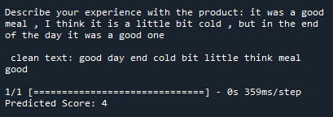
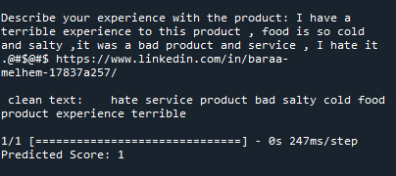
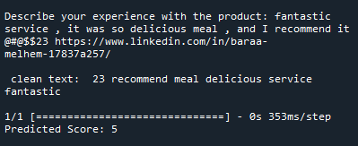
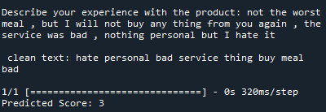
Some examples of using the model

Slide 15
The End

